Slide 1

MDA 720 Project
Sentiment Analysis of Hotel Reviews
- Pritika Khurana

Slide 2
Background
Customer reviews on hotels is a very important part of travel plan for people now a days.
People prefer to book hotels which have high number of positive reviews.
There are different sources to find the reviews to get a better insight about the hotel’s reputation.
Customer reviews plays an important part for business owners in order to improve their services.
Introduction
Leveraging on customer feedback available online, I performed sentiment analysis to determine the polarity (positive, negative, or neutral) of hotel reviews using machine learning models. This approach will enable us to obtain recent, credible, and trustworthy information on hotels based on customers' experiences. Ultimately, the data retrieved will inform a robust opening plan and play a critical role in launching a successful hotel into the marketplace.

Slide 3
Objectives/ Goals of the Project
The main objectives of this project:
Create a sentiment analysis model that is able to correctly classify customer ratings as positive, negative, or neutral.
Analyze customer reviews and ratings of hotels in a specific region, and identify key factors that impact customer satisfaction and loyalty.
Identify the most common problems and areas for improvement.
Based on the sentiment analysis results, provide suggestions for improving service quality at hotels that fit to the particular needs and preferences of customers.

Slide 4
Data Collection
In this project, I have taken data of multiple hotels through a predefined dataset and by web scraping. First we will see the predefined dataset.

Slide 5
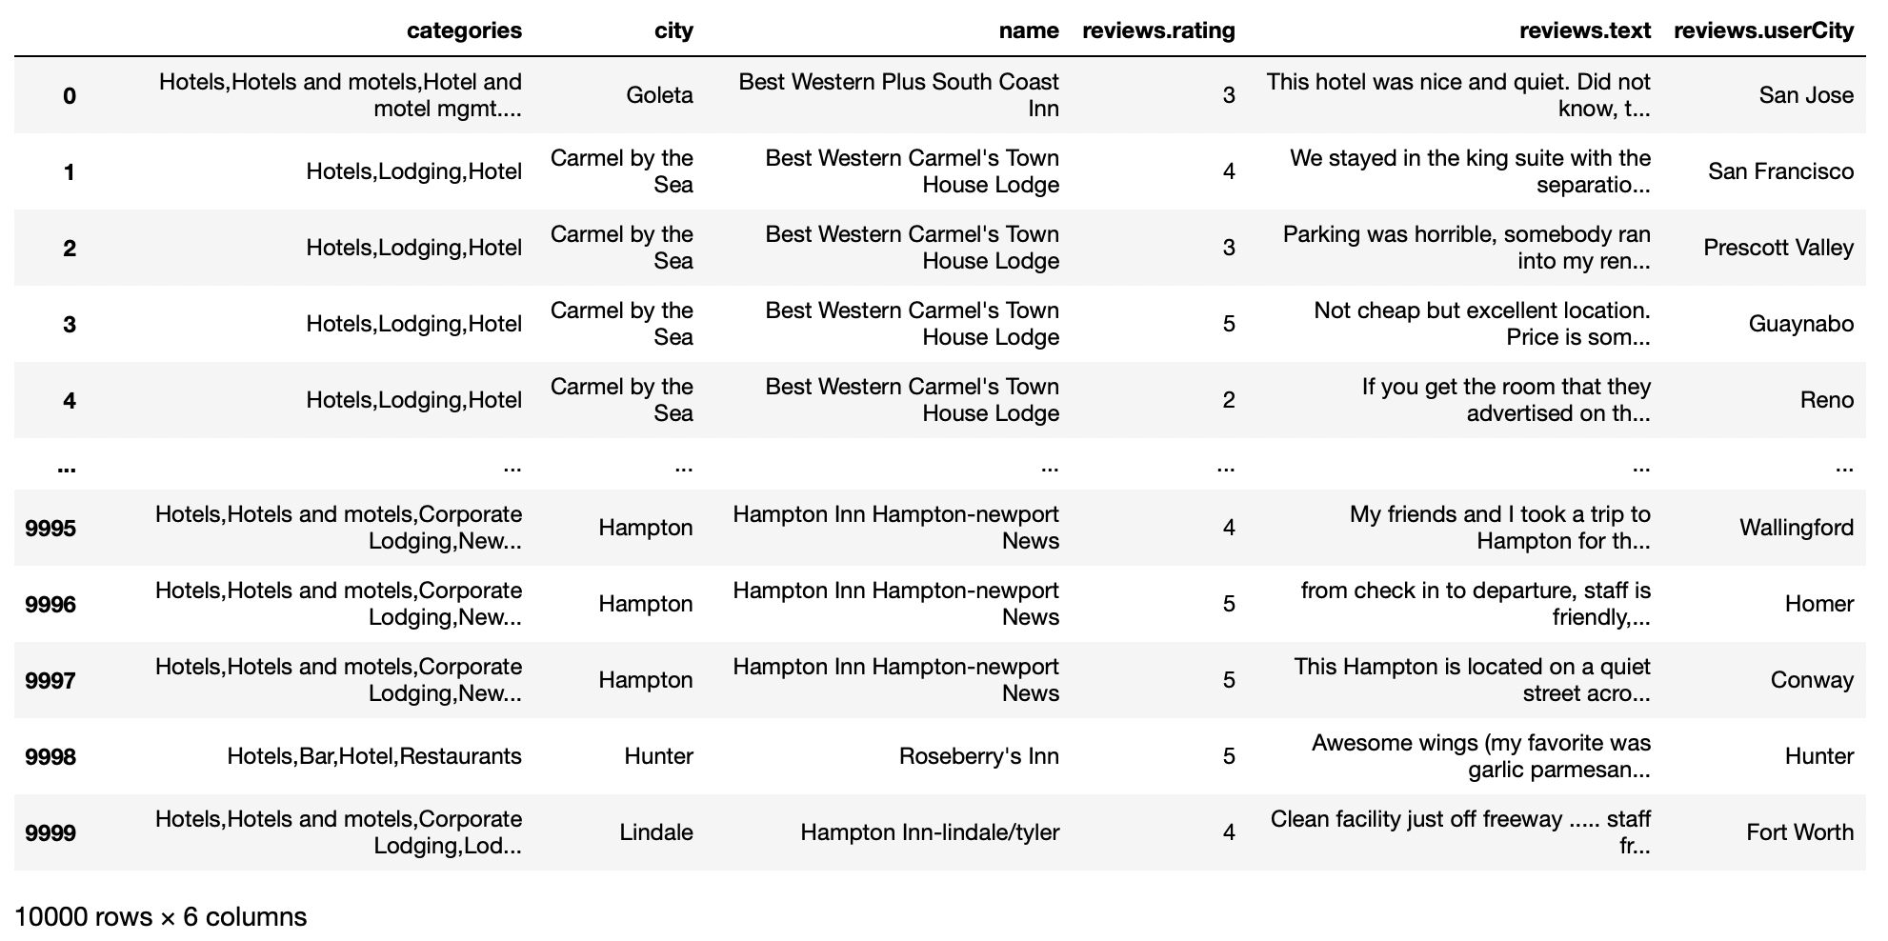
Data Exploration
For this project, the dataset is taken from kaggle.
Dataset initially contained 10,000 rows and 26 columns.
In this dataset, each row contains all the information related to a hotel, hotel’s review, rating as well as reviewer's information. There are many columns which are irrelevant for this project, I have taken only the most relevant columns into account. Since in this project the target is to perform simple sentiment analysis. Only 6 columns are kept.

Slide 6
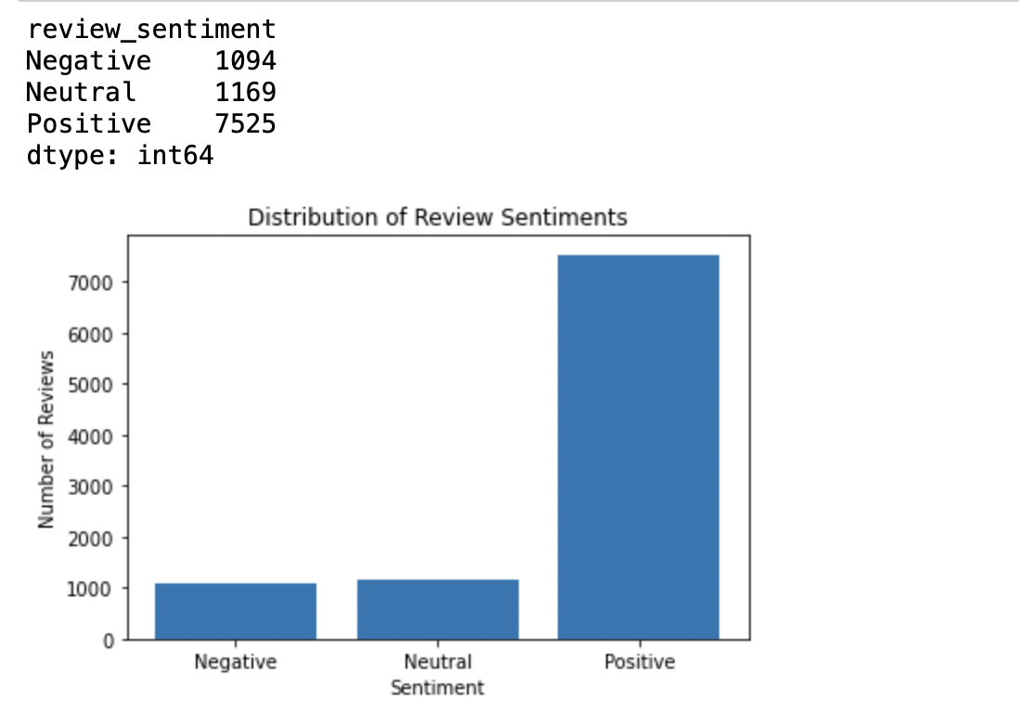
Data Visualization
The ratings is converted into class labels-
Positive, if Rating > 3
Neutral, if Rating = 3
Negative, if Rating < 3
The following figure describes the actual distribution of labels in complete dataset:
Shows that there are more positive reviews, but both neutral and negative reviews are fairly close in count.

Slide 7
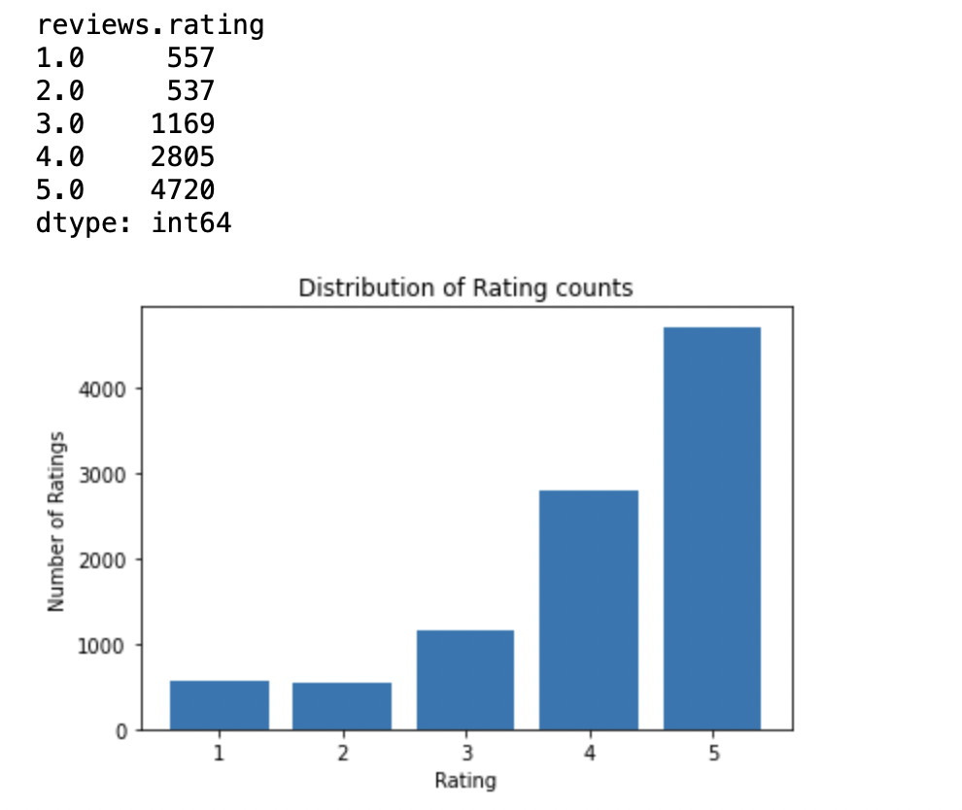
Data Visualization
The following figure describes the actual distribution of ratings in complete dataset:
Shows that most of the hotels in the dataset have 5 star rating then 4 star and 3 star. 1 star and 2 star are close in count.

Slide 8
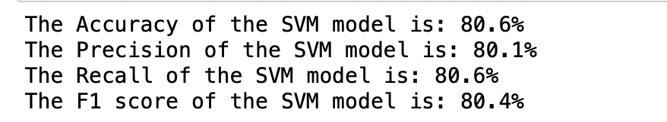
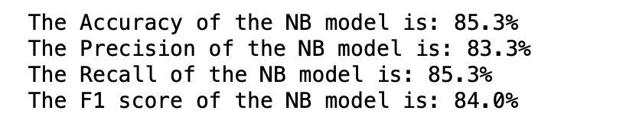
Classification Models
Support Vector Machine
Naive Bayes

Slide 9
Classification Models
NB model has a higher accuracy, precision, recall, and F1 score than the SVM model.
NB model is better at correctly identifying the sentiment of reviews in the dataset, with fewer false positives and false negatives.
NB model assumes that each feature (in this case, each word in the reviews) is independent of all other features, which allows it to be computationally efficient and to perform well with relatively small amounts of training data.
NB model works well with text data, which is often high-dimensional and sparse. On the other hand, the SVM model tries to find the best hyperplane that separates the positive and negative reviews in the dataset, which can be more complex and computationally expensive than the NB model. Additionally, SVMs require more tuning of hyperparameters and may perform poorly if the dataset is unbalanced or noisy.
The NB model has an accuracy of 85.3%, compared to 80.6% for the SVM model. Based on the evaluation metrics, it appears that the Naive Bayes (NB) model is performing slightly better than the Support Vector Machine (SVM) model.

Slide 10
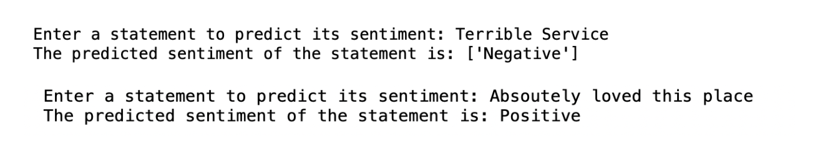
Testing Example Reviews
The hotel manager can input hotel reviews and obtain sentiment analysis results.
This can help hotel managers better understand the sentiment of their guests towards their services.

Slide 11


Web Scraping
Here I used the Yelp API to search for hotels in Manhattan, New York.
In this section I created an empty list to store the hotel data. It loops through the hotels returned in the Yelp API response, extracts the hotel names, ratings, and reviews, and performs sentiment analysis on each review.

Slide 12
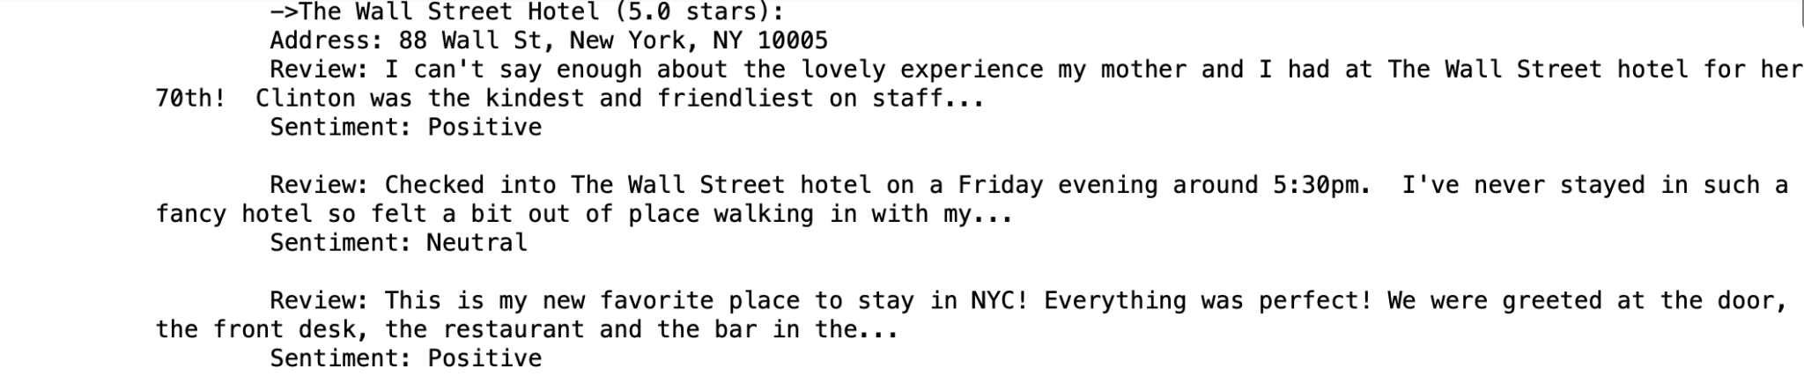
Data Retrieved

Slide 13
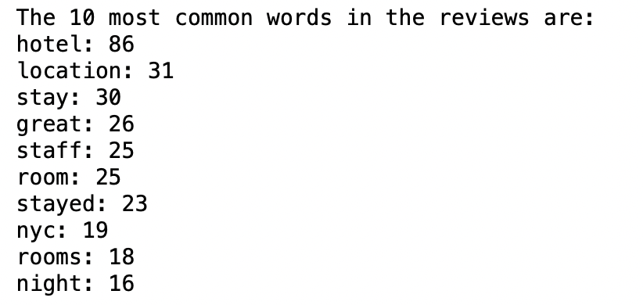
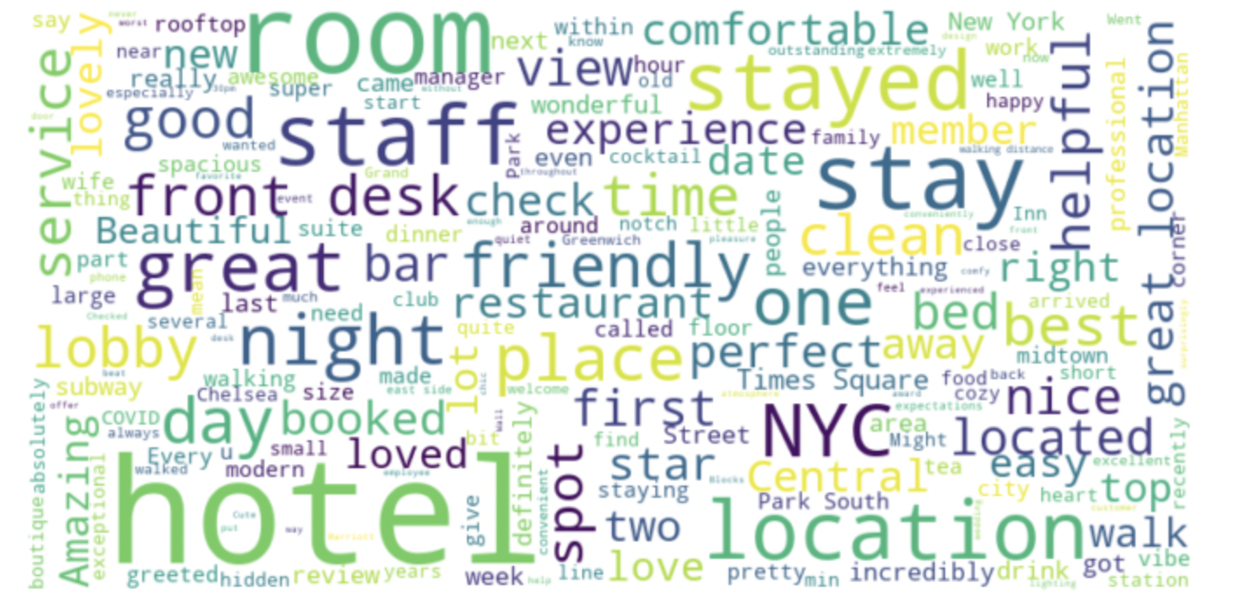
Finding the most common words in the review column
Here WordCloud is used. The purpose of this code is to visualize the most frequently occurring words in the hotel reviews in a visually appealing way. The larger the word in the word cloud, the more frequently it appears in the hotel reviews.

Slide 14
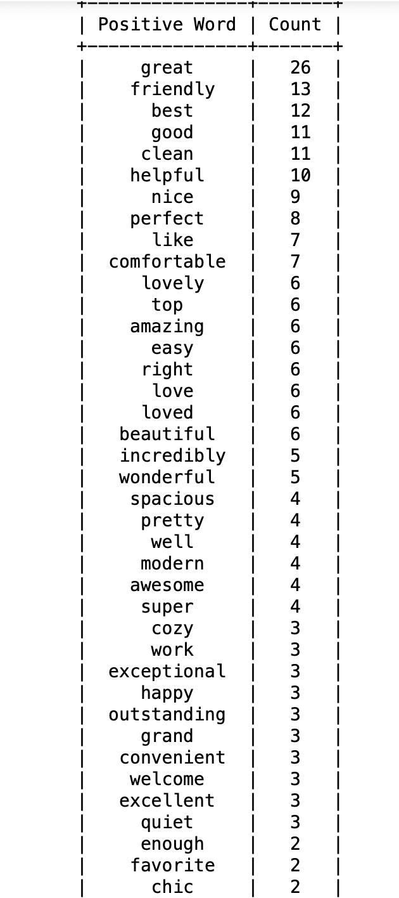
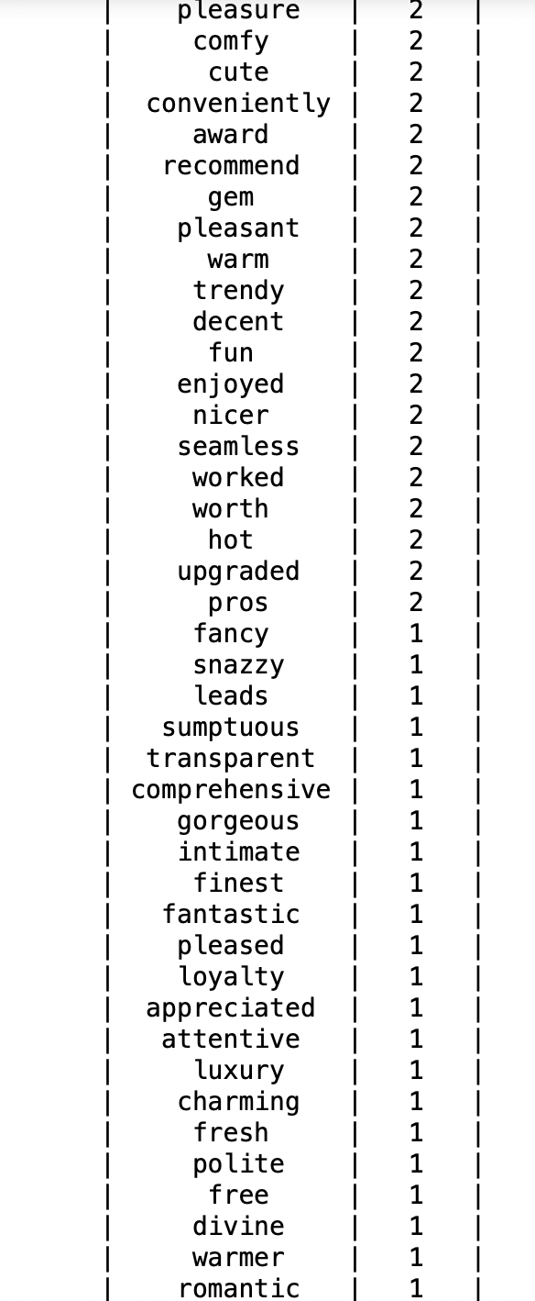
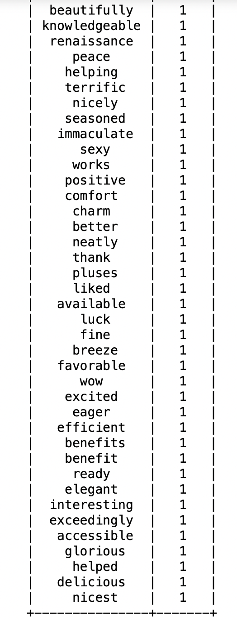
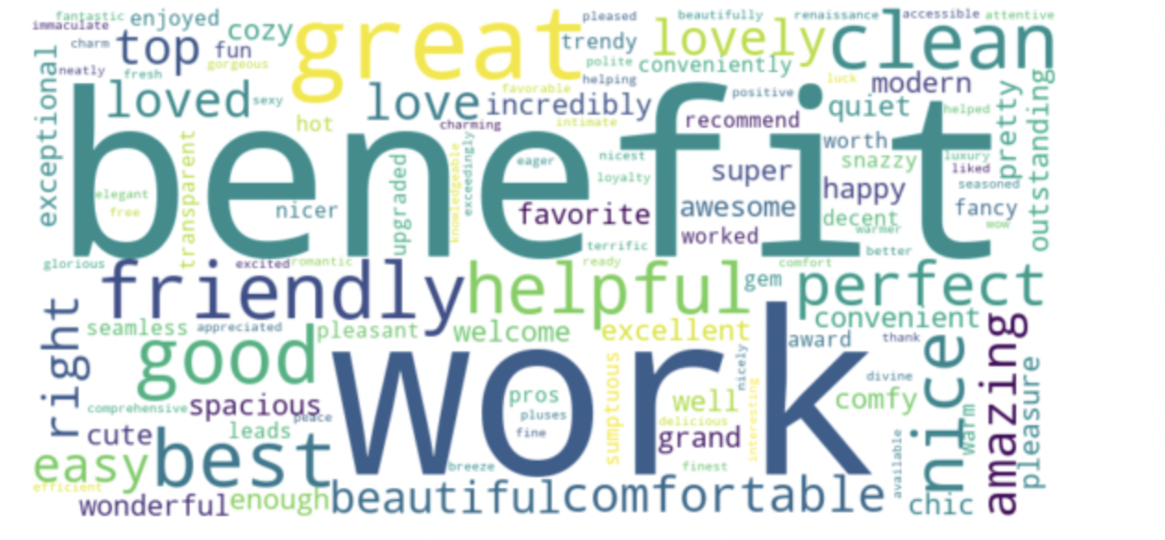
Finding the Positive words in the review column

Slide 15
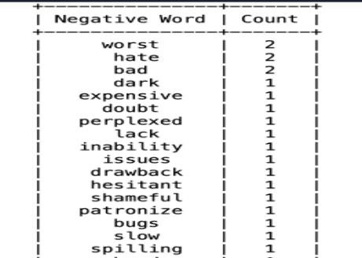
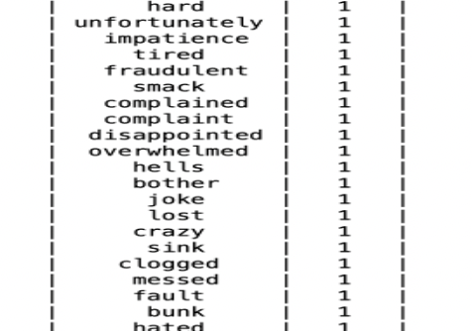
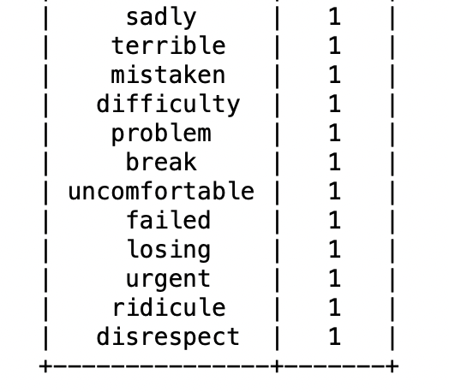
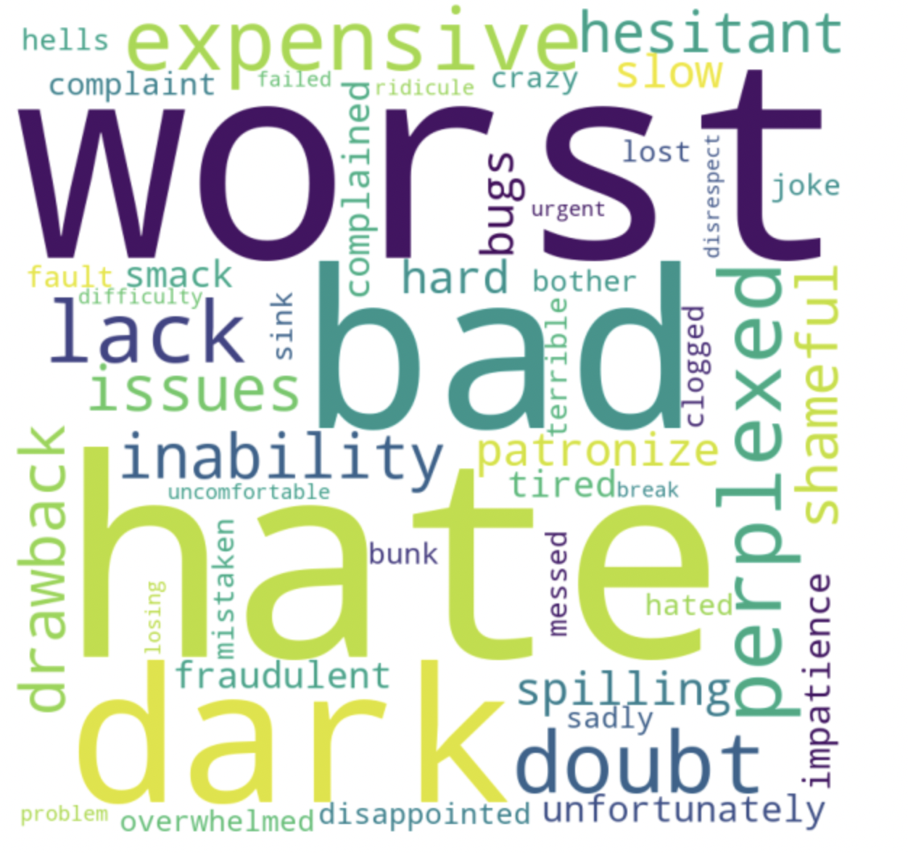
Finding the Negative words in the review column

Slide 16
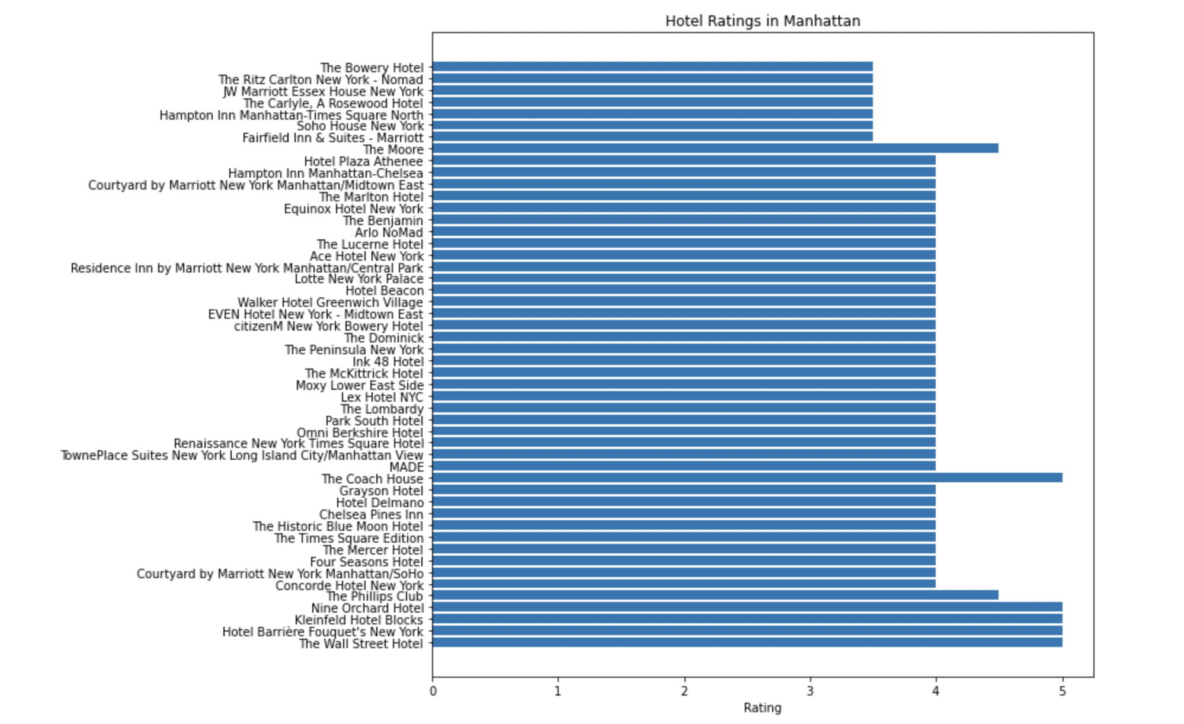
Relationship between Hotels and their rating
This chart is a visualization of the ratings of different hotels in Manhattan. It provides a quick and easy way to compare the ratings of different hotels at a glance.
The horizontal bar chart is used because it allows the viewer to easily see the ratings of each hotel and compare them to each other.
The chart can be useful for people who are looking for hotels in Manhattan and want to see which ones have the highest ratings.
It can also be useful for hotel owners or managers who want to compare the ratings of their hotel to those of their competitors.

Slide 17
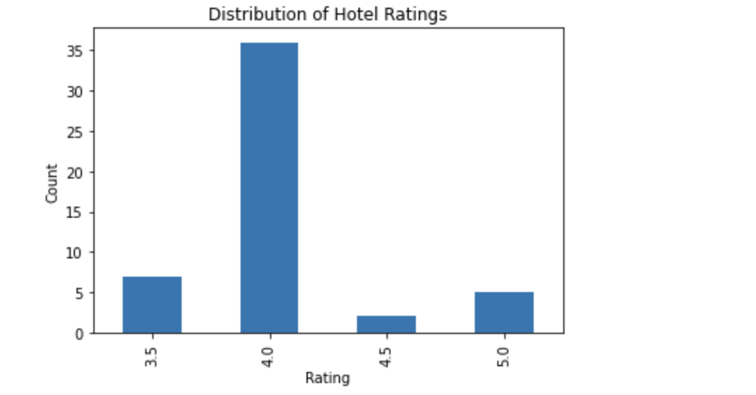
Relationship Rating and Count
This chart is created to visualize the distribution of hotel ratings in the dataset.
The chart shows the count of hotels that received each rating, which gives an overview of how the ratings are distributed among the hotels.
This type of chart is useful for understanding the distribution of a variable and identifying any patterns or anomalies in the data.
In this case, it can help identify if there are any rating categories that are overrepresented or underrepresented in the dataset.

Slide 18
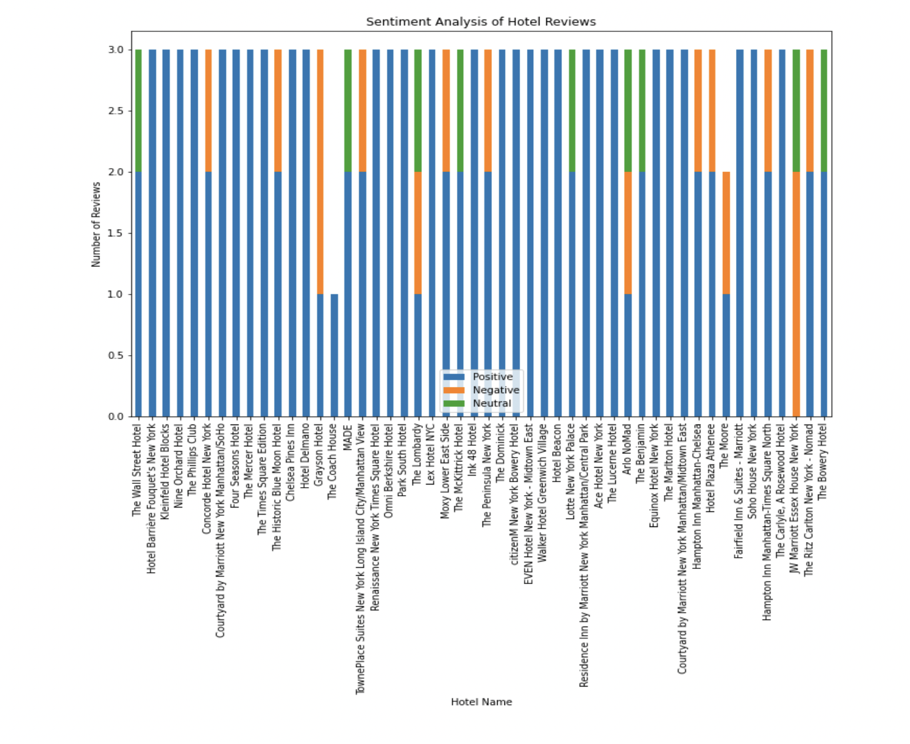
Sentiment Analysis of Hotel Reviews
The purpose of this chart is to provide a visual representation of the sentiment analysis results and to compare the sentiment distribution of different hotels. It can help identify which hotels have the most positive or negative reviews and provide insights into customer satisfaction levels.

Slide 19
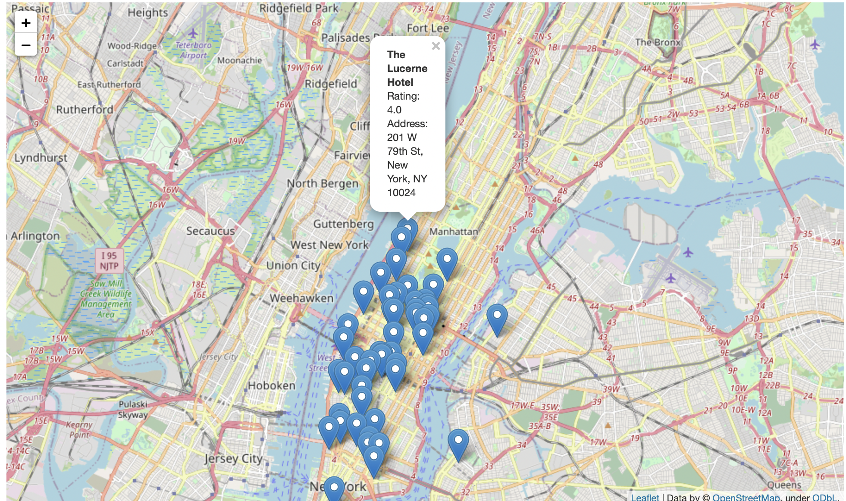
Geographic distribution of hotels in Manhattan
Visualizing the geographic distribution of hotels in Manhattan using the latitude and longitude information provided by the Yelp API. It suggests using the folium library in Python to create interactive maps.
The code creates a map object centered on Manhattan and adds markers for each hotel, displaying the hotel name, rating, and address when clicked. The purpose of this code is to visually inspect the geographic distribution of hotels in Manhattan and identify any areas with a high concentration of hotels.

Slide 20
Results
The main findings of this analysis indicate that the most important factors impacting customer satisfaction and loyalty are the quality of service, cleanliness, location, and price.
Positive reviews tend to emphasize the friendliness and professionalism of the staff, the cleanliness and comfort of the rooms, the convenience and accessibility of the location, and the value for money of the price.
Negative reviews tend to criticize the poor quality of service, the lack of cleanliness and maintenance, the inconvenience and discomfort of the location, and the high cost or poor value for money of the price.

Slide 21
Conclusion
The main contributions of this project include the identification of key factors that impact customer satisfaction and loyalty in the hotel industry, and the development of NB and SVM model that can predict customer sentiment based on textual reviews and ratings.
The main conclusions of this project are that hotels should focus on improving service quality, cleanliness, location, and price in order to enhance customer satisfaction and loyalty, and that future research should explore more advanced methods and data sources for analyzing customer sentiment and behavior.

